Slide 1

MODULE - 2

Slide 2
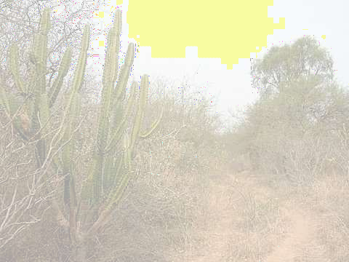



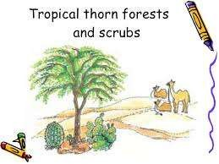
TROPICAL THORN FOREST AND SCRUBS
Receive less than 70cm rainfall.
It consist thorny bushes, scrubs, trees.
Trees have deep roots in order to get moisture.
Leaves are thick and small for minimum evaporation.
Areas covered
  Gujarat, Rajasthan, Madhya Pradesh, Chhattisgarh, Uttar Pradesh and Haryana.
Vegetation covered
  Acacias, palms, euphorbias and cacti.
Animals found
  rats, mice, rabbits, fox, wolf, tiger, lion, wild ass, horses and camels.

Slide 3




MONTANE FOREST
These forest are found between a height of 1000m to 2000m.
These are used extensively for
grazing by nomadic tribes like the Gujjars and the Bakarwals.
Areas covered
  tropical to the tundra region
Vegetation found
  Oaks, chestnuts predominate, pine, deodar, silver
fir, spruce, cedar, Silver fir, junipers, pines,
mosses, lichens and birches.
Animals found
  Kashmir stag, spotted dear, wild sheep, jack rabbit, Tibetan antelope, yak, snow leopard, squirrels, Shaggy horn wild ibex, bear and rare red panda,

Slide 4



MANGROVE FOREST
They are found in the areas of coast influenced by tides.
The roots of plants are submerged under water.
Areas covered
  The deltas of the Ganga, the
Mahanadi, the Krishna, the Godavari and the Kaveri.
Vegetation found
  sundari trees, hard timber, Palm, coconut, keora, agar.
Animals found
  Royal Bengal Tiger, Turtles, crocodiles, gharials and snakes.

Slide 5












MEDICINAL PLANTS
INDIA IS KNOWN FOR ITS HERBS AND SPICES FROM
ANCIENT TIMES. SOME 2,000 PLANTS HAVE BEEN DESCRIBED IN AYURVEDA AND ATLEAST 500 ARE IN REGULAR USE. THE WORLD CONSERVATION UNION’S RED LIST HAS NAMED 352 MEDICINAL PLANTS OF WHICH 52
ARE CRITICALLY THREATENED AND 49 ENDANGERED. THE COMMONLY USED PLANTS IN INDIA ARE:
SARPAGANDHA : Used to treat blood pressure; it is found only in India.
JAMUN : The juice from ripe fruit is used to prepare vinegar
which is carminative and diuretic, and has digestive
properties. The powder of the seed is used for controlling diabetes.
ARJUN : The fresh juice of leaves is a cure for earache. It
is also used to regulate blood pressure.
BABOOL : Leaves are used as a cure for eye sores. Its gum is used as a tonic.
NEEM : Has high antibiotic and antibacterial properties.
TULSI PLANT : Is used to cure cough and cold.
KACHNAR : Is used to cure asthma and ulcers. The buds and

Slide 6



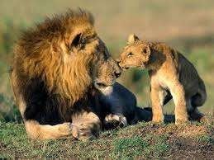
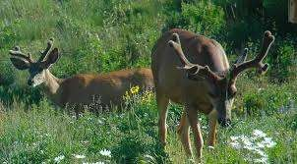




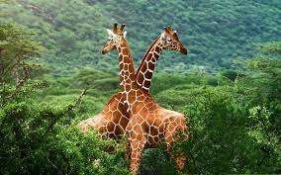
WILDLIFE

Slide 7


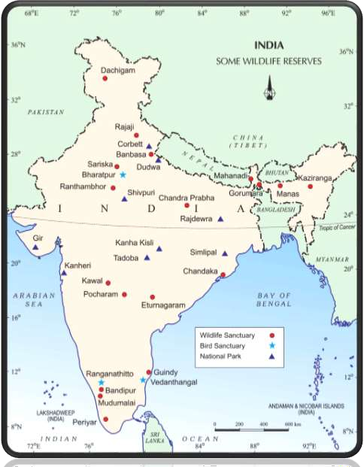
WILDLIFE RESERVES

Slide 8

















WILDLIFE IN INDIA
India has more than 89,000 animal species.
In India,
  The elephants, the most majestic mammal, are found in the hot wet forests of Assam, Karnataka and Kerala.
  One-horned rhinoceroses live in swampy and marshy lands of Assam and West Bengal.
  Arid areas of the Rann of Kachchh and the Thar Desert are the habitat for wild ass and camels respectively.
  Indian bison, neelgai, chousingha, gazel and

Slide 9




















India is the only country having lion and tigers.
  Asiatic lion is found Gir forest in Gujarat.
  Tigers are found in the forests of Madhya Pradesh, the Sundarbans of West Bengal and the Himalayan region.
Ladhak’s freezing cold is a home to yak, the shaggy horned wild ox the Tibetan antelope, the bharal wild sheep, and the kiang, the ibex, bear, snow-leopard and very rare red panda.
In the rivers, lakes and coastal areas turtles, crocodiles and gharials are found.
  Latter is the only representative of a variety of crocodile

Slide 10


SAVE ECOSYSTEM!!!
Due to excessive exploitation of the plants and animal human beings have disturbed the ecosystem.
About 1,300 plant species are endangered and 20 species are extinct.Quite a few animal species are also endangered and some have become extinctt.
The main causes of this extinction is humans.
Pollution
– Due to chemical and industrial waste, acid deposits, introduction of alien species and reckless cutting of the forests to bring land under cultivation and inhabitation, the ecosystem is also imbalanced.

Slide 11



STEPS TAKEN BY GOVERNMENT
Fourteen biosphere reserves have been set up in the country to protect flora and fauna.
  the Sunderbans in the West Bengal.
  Nanda Devi in Uttaranchal.
  the Gulf of Mannar in Tamil Nadu.
  the Nilgiris in Kerala, Karnataka and Tamil Nadu.
Government has also provided Financial and
technical assistance to many Botanical Gardens since 1992.
Many project have been introduced by the government like Project Tiger, Project Rhino, Project Great Indian Bustard.
Government has also setup 89 National Parks,
49 Wildlife sanctuaries and Zoological gardens take care of Natural heritage.

Slide 12


Slide 13


